Slide 1
Office 365 development

Slide 2
Deep dive into Microsoft Graph for OneDrive for Business
</>

Slide 3
Agenda
Overview
File operations with SharePointClient
File operations with Microsoft Graph

Slide 4
Developer vision

Slide 5
1
Overview

Slide 6
Which to use?
OneDrive
Accessible cloud storage for personal documents, photos, and files that can be accessed from anywhere
Best for user owned content
OneDrive for Business
Secure enterprise-grade storage for business documents and files
Best for business/enterprise-owned content
Depending on your app targeting both is appropriate

Slide 7
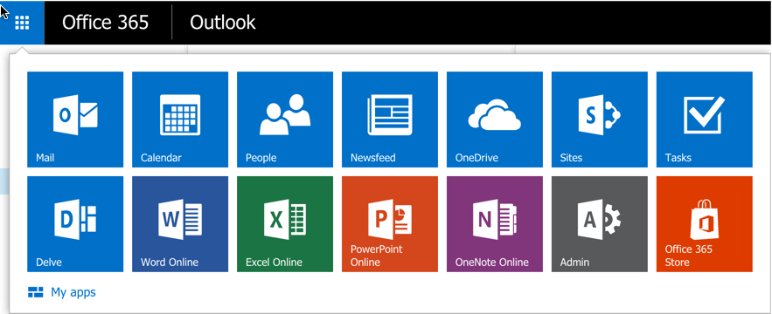
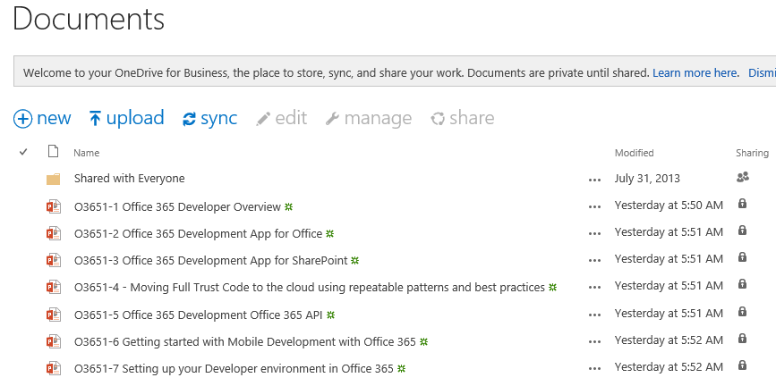
OneDrive for Business
A personal library for storing and organizing your work documents
Notes:
OneDrive for Business is a personal library intended for storing and organizing your work documents. As an integral part of Office 365 or SharePoint Server 2013, OneDrive for Business lets you work within the context of your organization, with features such as direct access to your organization’s address book.
Note OneDrive for Business is different from OneDrive, which is intended for personal storage separate from your workplace. OneDrive for Business is also different from your team site, which is intended for storing team or project-related documents.

Slide 8
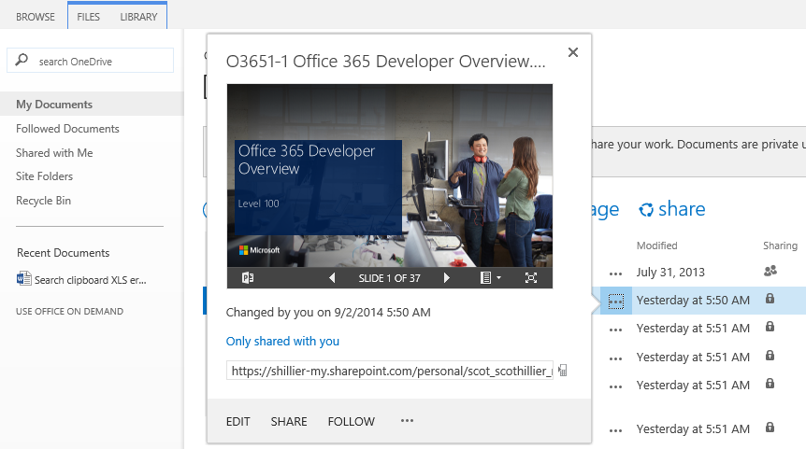
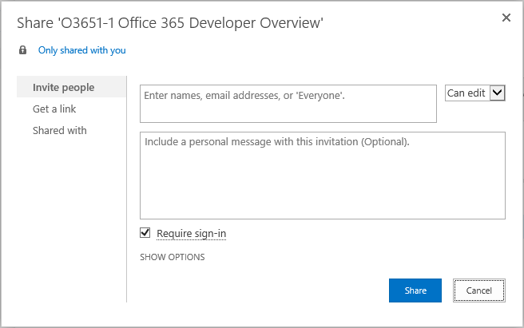
OneDrive for Business sharing
Notes:
The documents and folders you store in OneDrive for Business are private until you decide to share them. When you share documents and folders, you can decide whether to let people edit them, or just view them. You can also share documents or folders in a site library.
Note If you’re using Office 365, you may be able share documents with external users (people not on your network) by inviting them as “Guests,” or by creating and posting guest links

Slide 9
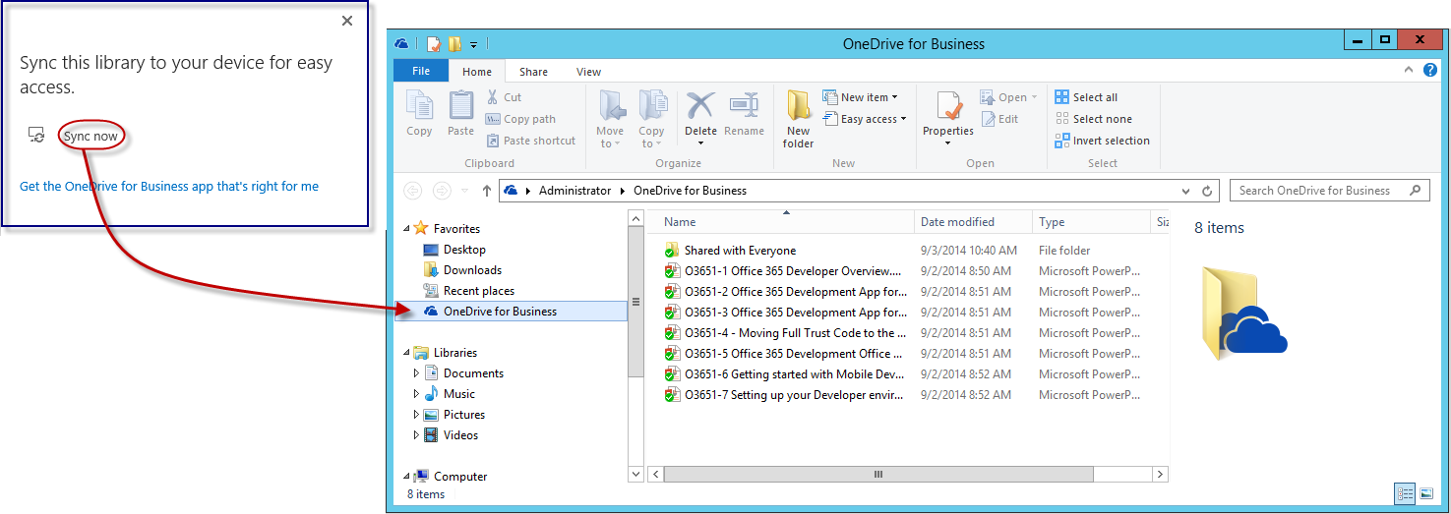
OneDrive for Business sync
Sync now
Get the OneDrive for Business app that’s right for me
Notes:
The OneDrive for Business sync app lets you synchronize your OneDrive for Business library or other SharePoint site libraries to your local computer. This sync app is available with Office 2013 or with Office 365 subscriptions that include Office 2013 applications. If you don’t have Office 2013, a free download of the OneDrive for Business sync app is also available.
To sync OneDrive for Business, sign in to Office 365 or SharePoint, select OneDrive at the top of the page, and then click Sync.
You’ll find your synchronized files in your File Explorer, under Favorites. If you’re syncing an Office 365 OneDrive for Business library, your synchronized files appear in the OneDrive@<organization> folder. Work on them locally if you like and your changes will be synchronized automatically with your OneDrive for Business library when you’re online.

Slide 10
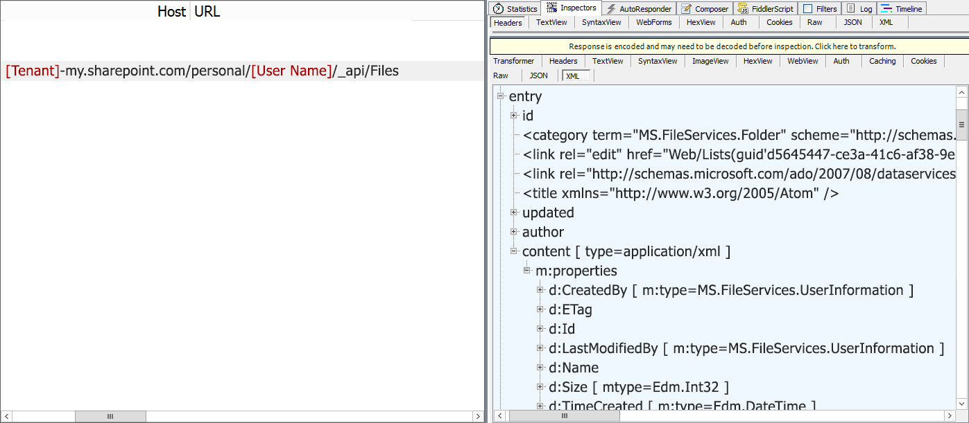
The Files API
https://[site]/_api/Files
“Entry” element for each file
File metadata
Notes:
_api/Files always targets the “Documents” library in a SharePoint site
For personal sites, this is the OneDrive for Business library

Slide 11
Use the colon to denote a path within the drive
/drive/root:/Contoso/ProjectA:/children
/drive/items/F0A1291828!101/children
Combine ID and path
/drive/items/F0A..19:/document1.docx
Address entities on items
/drive/items/F0A..19/thumbnails/0/large
Navigating items your way

Slide 12
Callable on any folder, not just the root
Based on a sync token, returns items changed since token was generated
Deleted items are returned with “deleted” property
Moving an item out of the hierarchy will make you resync
Sync changes

Slide 13
A home for content created in your app
Keep your app files in a known location
No need to create folders
Restricted access to only your folder makes your app more trustworthy
App folders

Slide 14
Upload up to 10 GB using this method
/upload.createSession
Provide the details of the file you are uploading
If the file is available on the internet, use “Upload from URL” instead
PUT fragments until complete
Create and upload requests with sequential fragments of the file until the whole file is uploaded
When the last fragment is received, the file is added to the user’s OneDrive
Large files

Slide 15
2
File operations with SharePointClient

Slide 16
SharePointClient class
Discovery Service discovers “MyFiles” capability
Returns tenant and user-specific URL for user’s OneDrive for Business
SharePointClient.Files abstracts Files API
DiscoveryContext disco = GetFromCache("DiscoveryContext") as DiscoveryContext;
var dcr = await disco.DiscoverCapabilityAsync("MyFiles");
return new SharePointClient(dcr.ServiceEndpointUri, async () =>
{
return await (disco.AuthenticationContext.AcquireTokenByRefreshTokenAsync(
new SessionCache().Read("RefreshToken"),
new Microsoft.IdentityModel.Clients.ActiveDirectory.ClientCredential(
disco.AppIdentity.ClientId,
disco.AppIdentity.ClientSecret),
dcr.ServiceResourceId)).AccessToken;
});
Notes:
The discovery service discovers the “MyFiles” capability, which will always try to access the OneDrive for Business library

Slide 17
Read files collection
Can also read an individual folder
Reading file metadata
Notes:
No support for $skip and $orderby so paging is post-query

Slide 18
Uploading a new file
Use AddAsync method
Provide a file name and the file stream
SharePointClient client = await EnsureClientCreated();
IFile file = await client.Files.AddAsync(filename, true, filestream);

Slide 19
Deleting a file
Get the target file using GetByAsync method
Delete using DeleteAsync method
SharePointClient client = await EnsureClientCreated();
IFileSystemItem fileSystemItem = await client.Files.GetByIdAsync(id);
await fileSystemItem.DeleteAsync();

Slide 20
3
File operations with Microsoft Graph

Slide 21
Graph for OneDrive for Business files
Get the metadata for all files in OneDrive
GET https://graph.microsoft.com/v1.0/me/drive/root/children
Get the metadata for an item in OneDrive
GET https://graph.microsoft.com/v1.0/me/drive/root:/{item-path}
GET https://graph.microsoft.com/v1.0/me/drive/items/{item-id}
Get the metadata for the children of a folder in OneDrive
GET https://graph.microsoft.com/v1.0/me/drive/root:/{item-path}:/children
GET https://graph.microsoft.com/v1.0/me/dirve/items/{item-id}/children
Download a single file from OneDrive
GET https://graph.microsoft.com/v1.0/me/drive/root:/{item-path and filename}:/content
GET https://graph.microsoft.com/v1.0/me/drive/items/{item-id}/content

Slide 22
Graph for OneDrive for Business files
Upload a file to the specified path in OneDrive (pass file in body)
PUT /drive/root:/{parent-path}/{filename}:/content
PUT /drive/items/{parent-id}:/{filename}:/content
Delete a file from OneDrive
DELETE /drive/root:/{item-path}
DELETE /drive/items/{item-id}
Get metadata for a folder and its children
GET /drive/root:/{folder-path}?$expand=children
GET /drive/items/{item-id}? $expand=children
Get selected metadata fields back for first five files in OneDrive
GET /drive/root:/{item-path}?$select=Name,Id,TimeCreated,Size&$top=5
GET /drive/items/{item-id}?$select=Name,Id,TimeCreated,Size&$top=5

Slide 23
Reading file metadata
GET Files endpoint
string OneDriveRoot = "https://graph.microsoft.com/v1.0";
StringBuilder requestUrl = new StringBuilder(OneDriveRoot)
.Append("/me/drive/root/children")
.Append("?$select=Name,Id,WebUrl,CreatedDateTime,LastModifiedDateTime");
HttpClient client = new HttpClient();
HttpRequestMessage request = new HttpRequestMessage(HttpMethod.Get, requestUrl.ToString());
request.Headers.Accept.Add(new MediaTypeWithQualityHeaderValue("application/xml"));
request.Headers.Authorization = new AuthenticationHeaderValue("Bearer", await GetAccessTokenAsync());
HttpResponseMessage response = await client.SendAsync(request);
string responseString = await response.Content.ReadAsStringAsync();
Notes:
Note that the OneDrive URI is hard-coded just for clarity. Normally, you would get this from the discover service.
Paging is implemented using a $skipToken parameter on the query

Slide 24
Uploading a new file
PUT to Add endpoint
Provide a file name and the file stream
string OneDriveRoot = "https://graph.microsoft.com/v1.0";
StringBuilder requestUrl = new StringBuilder(OneDriveRoot)
.Append("/me/drive/root:/")
.Append(fileName).Append(":/content");
HttpClient client = new HttpClient();
HttpRequestMessage request = new HttpRequestMessage(HttpMethod.Put, requestUrl.ToString());
request.Headers.Accept.Add(new MediaTypeWithQualityHeaderValue("application/xml"));
request.Headers.Authorization = new AuthenticationHeaderValue("Bearer", await GetAccessTokenAsync());
request.Content = new StreamContent(fileStream);
HttpResponseMessage response = await client.SendAsync(request);
string responseString = await response.Content.ReadAsStringAsync();
Notes:
Note that the OneDrive URI is hard-coded just for clarity. Normally, you would get this from the discover service.

Slide 25
Deleting a file
DELETE the target file ID
string OneDriveRoot = "https://graph.microsoft.com/v1.0";
StringBuilder requestUrl = new StringBuilder(OneDriveRoot)
.Append("/me/drive/items/")
.Append(fileId);
HttpClient client = new HttpClient();
HttpRequestMessage request = new HttpRequestMessage(HttpMethod.Delete, requestUrl.ToString());
request.Headers.Accept.Add(new MediaTypeWithQualityHeaderValue("application/xml"));
request.Headers.Authorization = new AuthenticationHeaderValue("Bearer", await GetAccessTokenAsync());
HttpResponseMessage response = await client.SendAsync(request);
Notes:
Note that the OneDrive URI is hard-coded just for clarity. Normally, you would get this from the discover service.

Slide 26
File operations with Microsoft Graph
demo

Slide 27
Key differences from OneDrive with SharePoint Files API
Authentication: Need to target AAD or MSA depending on user type. Auth scopes are different as a result.
Discovery: OneDrive for Business doesn’t have a common API endpoint, so discovery API is still necessary.
Code Base: SDK is different.
Similarities
Both need to get the access token before calling the API.
Microsoft Graph for OneDrive for Business

Slide 28
Office 365 direct API endpoints
Direct API endpoints for all the Office 365 Services may also be invoked
Outlook, OneDrive, OneNote, etc.
Direct endpoints have new functionality before it is exposed via the Graph API
Examples:
Outlook web hooks
Time zone on calendar

Slide 29
Related code samples
OneDrive API Explorer (JavaScript)
http://github.com/OneDrive/onedrive-explorer-js
OneDrive API Explorer (Windows/C#)
http://github.com/OneDrive/onedrive-explorer-win
Picker and Saver for JavaScript
https://dev.onedrive.com/sdk/javascript-picker-saver.htm

Slide 30
Related documentation
Office dev— Microsoft Graph for
OneDrive reference
https://graph.microsoft.io/docs/api-reference/v1.0/resources/drive
OneDrive Dev Center
https://dev.onedrive.com/

Slide 31
Summary
Overview
File operations with SharePointClient
File operations with Microsoft Graph

Slide 32
Developer Program launch
1 YEAR FREE
Email Newsletters
Free Developer Subscription
Free Training
Free Tools
Webinars
http://dev.office.com/devprogram

Slide 33
Engage

